Slide 1
WORDCLOULD OF BRITISH AIRWAYS
-Mohamed Maaz Rehan
md.maaz.1992@gmail.com
+91 9945263606

Slide 2
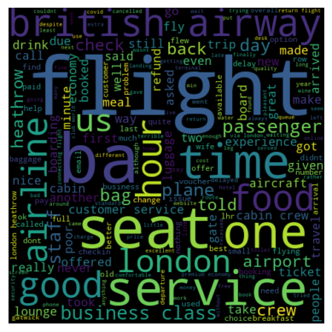
WORDCLOULD OF BRITISH AIRWAYS

